Slide 1
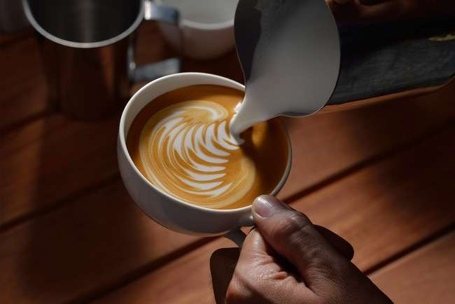

VINTIQ
Vintiq Coffee Hub Unveiled
NOVEMBER 15,2023
VINTIQ. COM

Slide 2

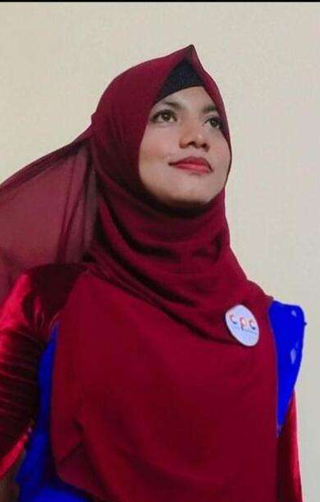
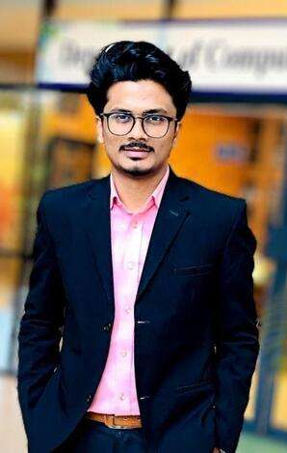
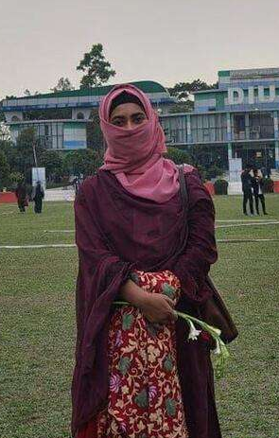
OUR TEAM
Sumaiya binte mizan
221-15-5077
Siam akter mim
221 - 15 - 5924
Md. Abir hasan
221- 15 - 5459

Slide 3





SUBMITTED TO
Lecturer
Daffodil international university
Mustofa ahmed
CSE 226

Slide 4
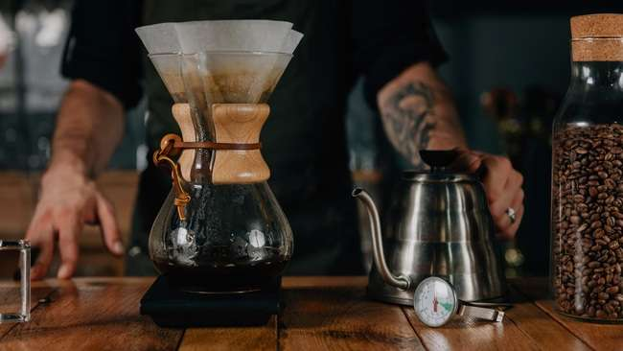

VINTIQ. COM
VINTIQ
Table Of Contents
01.
06.
Welcome
Target audience
02.
07.
Other applications
Business model
03.
Problem in other applications
08.
Revenues
04.
09.
Introduction
Costs
05.
10.
Vision & Mission
Conclusion

Slide 5



Welcome
Message
If you're ready for a perfect cup of coffee, let's get started.
Every cup of coffee should be as unique as the person who drinks it. Coffee is more than just an ordinary drink. It's about the experience, the ritual, and the pursuit of perfection.
Vintiq. Com
Coffee shop

Slide 6





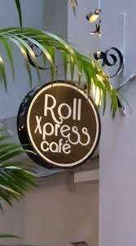

Other Applications
North End Coffee Roasters
TABAQ COFFEE
Roll Xpress Café
North End Coffee Roasters, based in Dhaka, Bangladesh, specializes in premium single-origin and local blends, with a focus on quality roasting and community partnerships.
Tabaq, Dhaka's coolest coffee spot, serves the town's best Oreo cheesecake and offers a welcoming ambiance with excellent service.
Roll Xpress Café in Banani, Dhaka: the best rolls, heavenly desserts, and a cozy ambiance for quick bites or family dinners.

Slide 7






Problem in other applications
01
Website Navigation and Load Time
02
Mobile Responsiveness
03
Payment Options
04
Online Ordering Clarity
05
Content Update & Diverse Content
06
Limited Online Presence

Slide 8

Solution
04.
Enhance online ordering clarity by simplifying the checkout process, providing clear instructions, and ensuring user-friendly navigation.
01.
Optimize website: streamline navigation, compress images, and enhance code for faster load times.
Keep the website dynamic by regularly updating content and diversifying it to engage users with fresh and varied information.
05.
02.
Ensure mobile responsiveness by employing responsive design principles, adapting content seamlessly across various devices.
Boost online presence: leverage social media, engage with audiences, and utilize content marketing for broader visibility.
06.
03.
Diversify payment options by including popular methods such as credit/debit cards, digital wallets, and ensuring a seamless checkout experience.
Solution

Slide 9

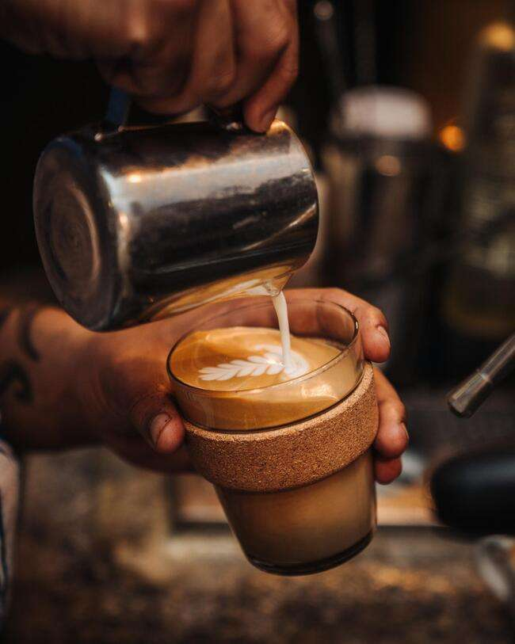

Welcome to Vintiq, where we blend passion and perfection in every cup. Established in 2022, we're dedicated to redefining the coffee experience. From the finest global beans to our warm ambiance, Vintiq is more than a coffee shop; it's a destination for flavorful moments and connections. Join us in savoring the artistry of coffee at Vintiq – where every sip is a celebration.
OUR PRODUCT
  Signature
  Fancy
  Classic
  Non Coffee
  Snack
  Etc

Slide 10


Vision
Crafting exceptional coffee experiences by sourcing the finest beans, fostering a warm and inclusive atmosphere, and contributing positively to the local community through sustainable practices and meaningful partnerships.
To be the heart of the community, where every cup of coffee fosters connections, inspires creativity, and creates a welcoming haven for coffee enthusiasts.
Mission

Slide 11



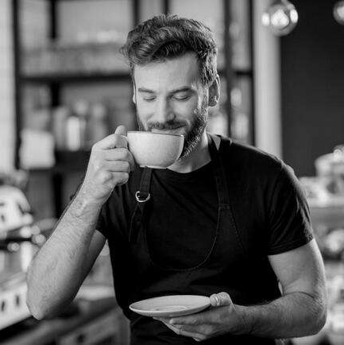

Target Audience
Adults (Ages 18-30)
Middle-Aged (Ages 31-50)
This group may be interested in coffee products due to health consciousness, environmental concerns, and a desire for sustainable living.
This group is typically more established in their careers and may have families. They may be interested in coffee products for their health.
Elders (Ages 50+)
Gender
Maximum seniors are interested in coffee products for their potential health benefits. They may appreciate the quality and taste of coffee products.
Men & female
Location
Urban & rural
Income Level
Low , middle & high

Slide 12
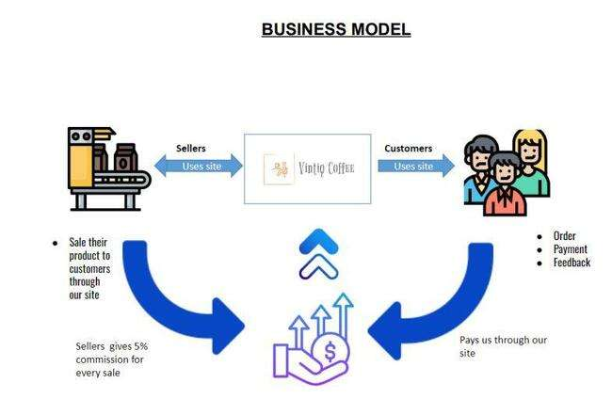
Business Model

Slide 13



Revenue
Product or Service Sales
Pricing Strategy
Subscription Models
Licensing and Royalties
01
02
03
04

Slide 14
Revenue
Affiliate Marketing
Advertising Revenue
Upselling and Cross-Selling
Online Platforms and E-commerce
05
06
07
08

Slide 15

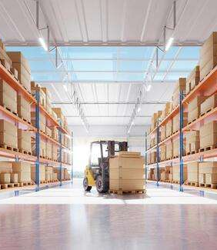



vintiq.com
Cost
01.
02.
03.
04.
Production Costs
Operational Expenses
Marketing and Advertising Costs
Employee Expenses

Slide 16




vintiq.com
Cost
05.
06.
07.
08.
Distribution and Logistics Costs
Technology and Software Expenses
Research and Development (R&D) Expenses
Administrative Costs

Slide 17





vintiq.com
Conclusion
Our coffee shop is more than a destination for exceptional brews; it's a community hub where the love for coffee meets a warm and inviting space. From meticulously sourced beans to fostering meaningful connections, we're dedicated to providing an enriching experience that goes beyond the cup. Welcome to a place where every sip tells a story.
Special coffee

Slide 18

Sumaiya
30%
Abir
40%
Contribution
Mim
30%
Team members
The largest slice, representing 40%, indicates that Abir holds the majority share.
The second slice, representing 30%, shows that Mim has a substantial but smaller portion compared to Abir.
The third slice, also at 30%, is equal in size to Mim's, signifying that Nijhum shares an equal percentage.
Sumaiya
Abir
Mim

Slide 19


VINTIQ.COM
THANK YOU
NOVEMBER 15,2023
VINTIQ

